Slide 1
LET THE CLOUD TRANSFORM YOUR ORGANISATION -
THE AWS EXAMPLE
Hamin Mousavi
2020 02 06

Slide 2

QUICK INTRO
Who am I?
hamin.se
linkedin.com/in/haminm
Hamin Mousavi
Senior cloud architect
Using AWS since 2008
Passion for:
Upskilling organisations, DevOps, CI/CD

Slide 3
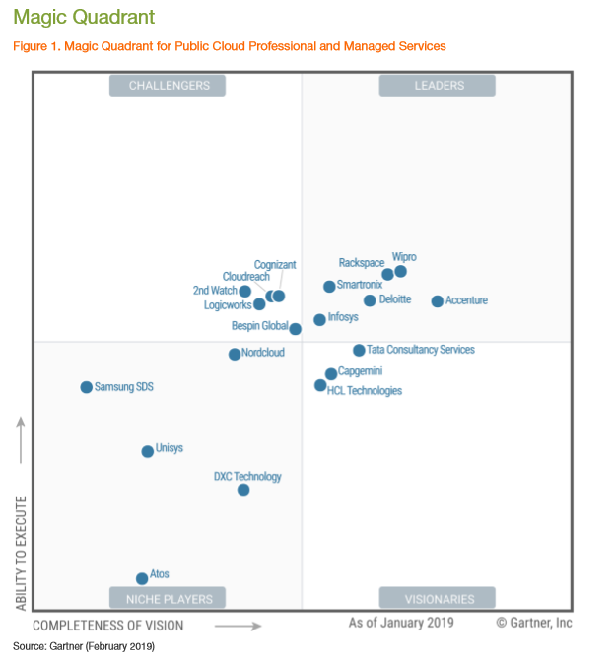
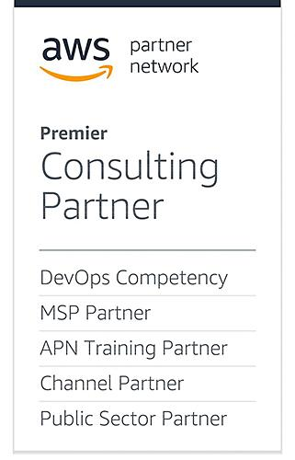

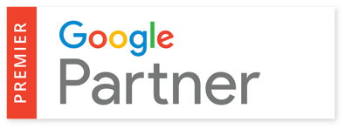
NORDCLOUD: PREMIER PARTNER
Nordcloud – Partners & Recognition

Slide 4
IT-TRANSFORMATION:
CLOUD REQUIRES NEW WAYS OF WORKING

Slide 5

KEY LEARNINGS FROM 100+ ENTERPRISE TRANSFORMATIONS
Make strategic decisions
Use strong sponsors
Competence is key
Start small and scale
Consider legacy blockers & mindset early

Slide 6

HOW TO SUCCEED IN AWS
Cloud Goals
Run IT Operations and Development so that cloud benefits are maximized

Slide 7

WHY ARE OUR CUSTOMERS USING AWS?
Why Cloud?
Agility, DevOps and Developer productivity
IT reliability and performance
Managed platforms and services
Application modernization
Global reach for hosting
Turn CapEx into OpEx and pay as you go

Slide 8
ENTERPRISE CLOUD JOURNEY
BUSINESS DRIVERS
BUSINESS OUTCOMES
TRANSFORMATION IN WAY OF WORKING

Slide 9
ENTERPRISE CLOUD JOURNEY
STRATEGY & GOVERNANCE
BUSINESS DRIVERS
BUSINESS OUTCOMES
Design & Validate approach
TRANSFORMATION IN WAY OF WORKING

Slide 10
ENTERPRISE CLOUD JOURNEY
STRATEGY & GOVERNANCE
FOUNDATION
BUSINESS DRIVERS
BUSINESS OUTCOMES
Design & Validate approach
Build cloud landing zone and processes, implement governance
TRANSFORMATION IN WAY OF WORKING

Slide 11
ENTERPRISE CLOUD JOURNEY
Build new software with DevOps
STRATEGY & GOVERNANCE
FOUNDATION
INNOVATION
BUSINESS DRIVERS
BUSINESS OUTCOMES
MIGRATION
OPTIMISATION
Design & Validate approach
Build cloud landing zone and processes, implement governance
Migrate existing apps
Platform development and optimisation
TRANSFORMATION IN WAY OF WORKING

Slide 12
EXAMPLE:
IMPACT OF INFRASTRUCTURE AS CODE

Slide 13

TIME TO MARKET WITH LEGACY
Cloud requires new ways of working
A web application
Order networks, storage, VMs, firewalls, databases, etc.
Maintain the infrastructure & facilities
Scale by ordering and installing new hardware
Manual patching on both hardware and software
Weeks of manual work
Time to market with legacy: 1-3 Months?

Slide 14
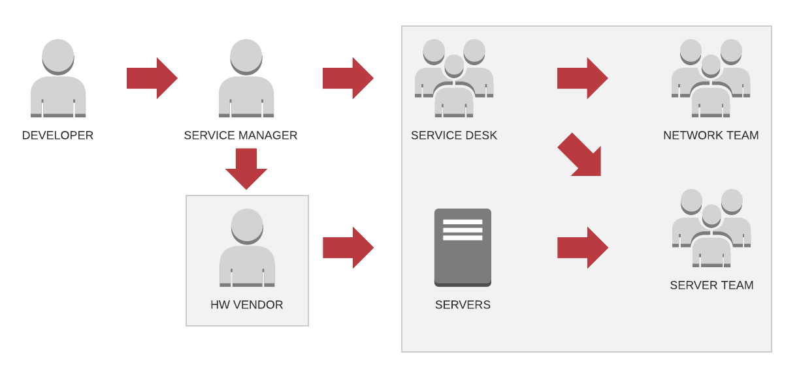
CHANGE PROCESS: LEGACY
Cloud requires new ways of working

Slide 15
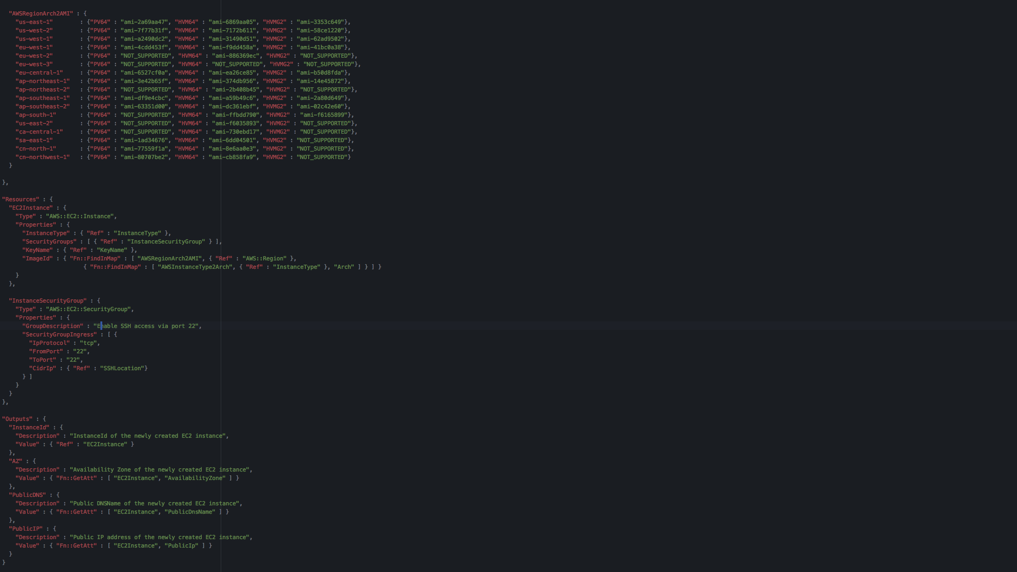
TIME TO MARKET WITH AWS
Cloud requires new ways of working
A web application
3 networks (public / private / dmz)
Automatically patched servers
Firewall with DDoS protection
Automatic scaling
2 replicated database servers
Instantly reproducible in any continent
Entire infrastructure in 255 lines of code
Time to market with cloud: 5-10 minutes

Slide 16
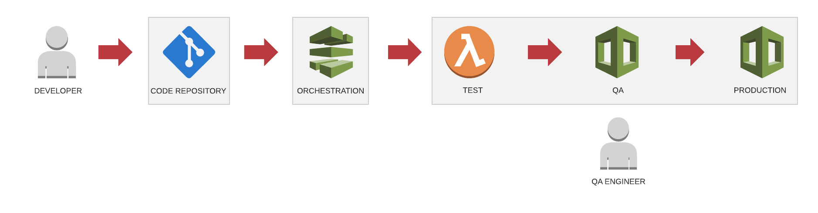
CHANGE PROCESS: CLOUD
Cloud requires new ways of working

Slide 17
CHANGE ON PERSONAL LEVEL: DBA TIME SPENT
Cloud requires new ways of working
Application
Database
Application
Monitoring
Access
Database
Monitoring
Platform
Access
Platform
TRADITIONAL DB
MANAGED DB

Slide 18
YOUR IT-ORGANISATION MAPS INTO AWS CLOUD SERVICES

Slide 19
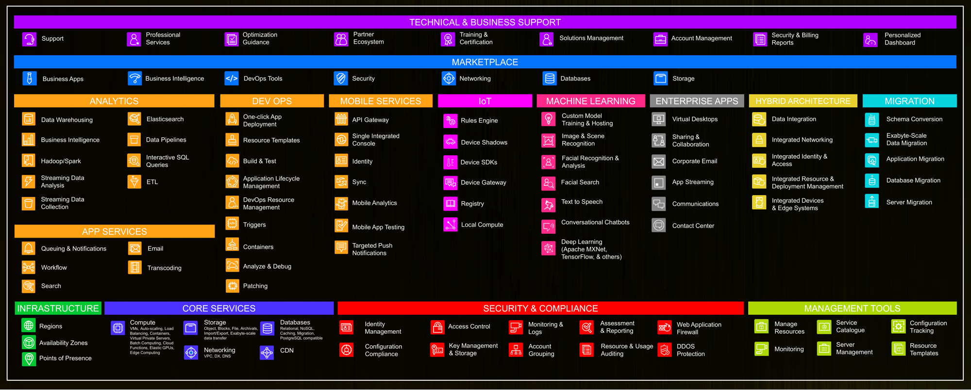
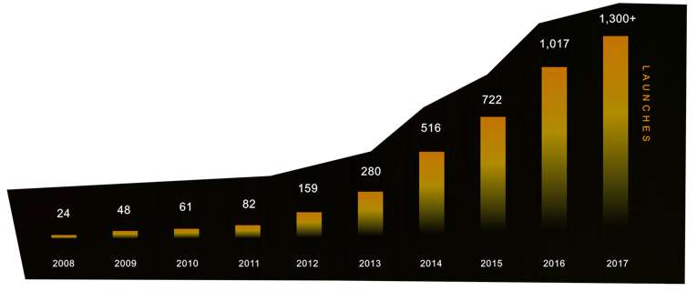
AWS SERVICES
Why Cloud?

Slide 20
CLOUD SHARED SECURITY MODEL
SECURITY IN THE CLOUD - CUSTOMER RESPONSIBILITY
Customer Data
Customer IAM
Platform & Application Management
Operating System, Network & Firewall Configuration
Client-side encryption & data integrity, authentication
Server-side encryption
including file systems & data
Network traffic protection, including encryption, integrity & identity
SECURITY OF THE CLOUD - VENDOR RESPONSIBILITY
Vendor Endpoints (API)
Foundation
Services
Vendor IAM
Compute
Storage
Databases
Networking
Vendor Global Infrastructure
Regions
Availability Zones
Edge Locations

Slide 21
CLOUD NATIVE GOVERNANCE
Speed with Control
Developers
Cloud Custodian Team
Operations
Built-in controls through policy instead of workflow

Slide 22
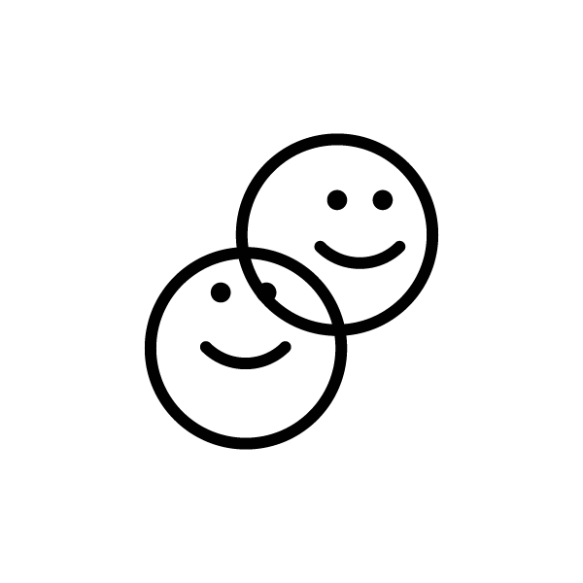


AWS IS API DRIVEN
CLOUD PLATFORM
API
Command line tools, Infrastructure as Code, SDKs
compute, network, storage...
Login
API
Cloud Management Console in browser

Slide 23
AUTHENTICATION LAYERS
AWS Resources
Virtual Machines
Applications
Directory federation
AWS Session Manager
AWS Cognito

Slide 24
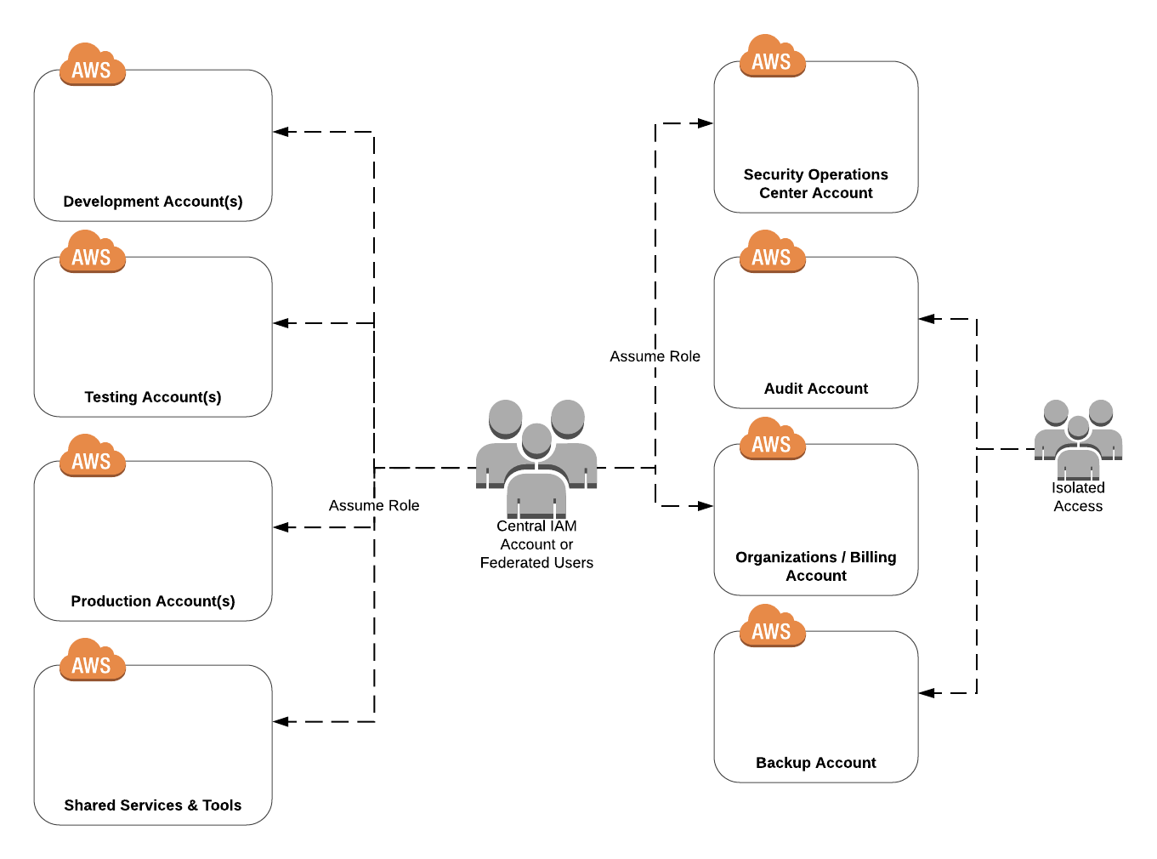
TYPICAL AWS ACCOUNT STRUCTURE

Slide 25

AUDIT DATA FLOW
Shared Services & Tools
Audit
SoC
Production
Development
Audit data
Audit data copy
Disaster Recovery
IAM

Slide 26
REFOCUSING THE IT ORGANISATION
Cloud requires new ways of working
 | Physical + Private Cloud | IaaS + Containers | PaaS + Serverless
Application / Software
Data
Application Server, DB, ...
OS
Virtualization
Hardware
Networking
Datacenter Facilities

Slide 27

BUILD UP: CLOUD AND PROJECT GOVERNANCE
Cloud Governance
Cloud Steering Board
Alignment
DevOps Teams
Cloud Competence Center
Cloud Operations / Managed Services

Slide 28

Evolution of Cloud Competence Center
Evolving the team
Tribe
Tribe
Tribe
BUILD UP
Typical team 3-4 people
SCALE UP
Typical team around 10 people
SCALE OUT
Team size depends on selected model and scale.
Pure technology focus
Transformation focus

Slide 29

WHERE IS YOUR ORGANISATION?

Slide 30
KEY LEARNINGS FROM 100+ ENTERPRISE TRANSFORMATIONS
Make strategic decisions
Use strong sponsors
Competence is key
Start small and scale
Consider legacy blockers & mindset early

Slide 31
THANK YOU!
Let’s stay in touch - We’re at booth 5
hamin.mousavi@nordcloud.com
hamin.se
linkedin.com/in/haminm

